Slide 1
Humidity and Condensation

Slide 2
Vocabulary
Water Vapor
Condensation
Specific Humidity
Relative Humidity
Saturated
Dew Point

Slide 3
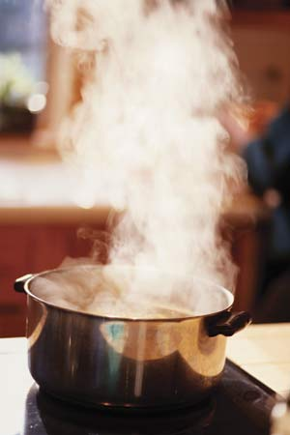
Water Vapor
An invisible gas formed when water reaches 100 degrees Celsius

Slide 4
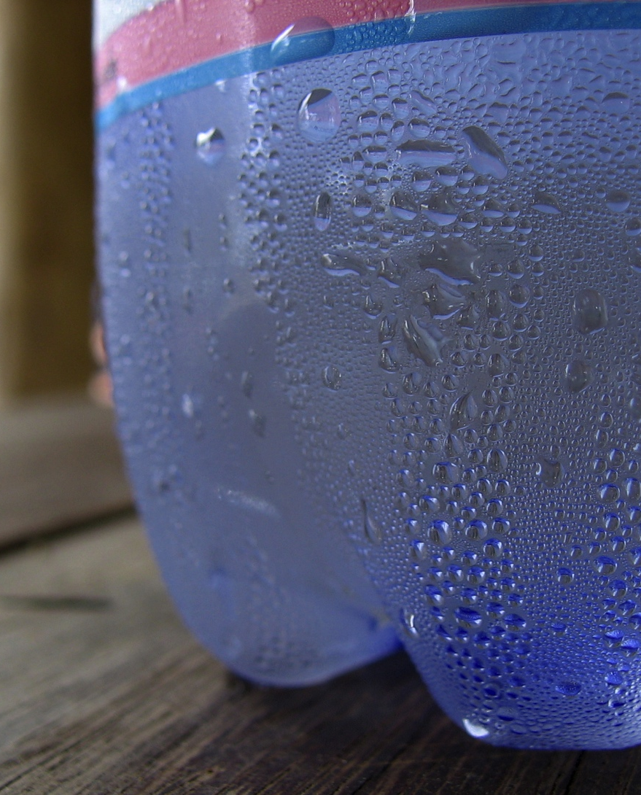
Condensation
The change from water vapor to liquid water.

Slide 5
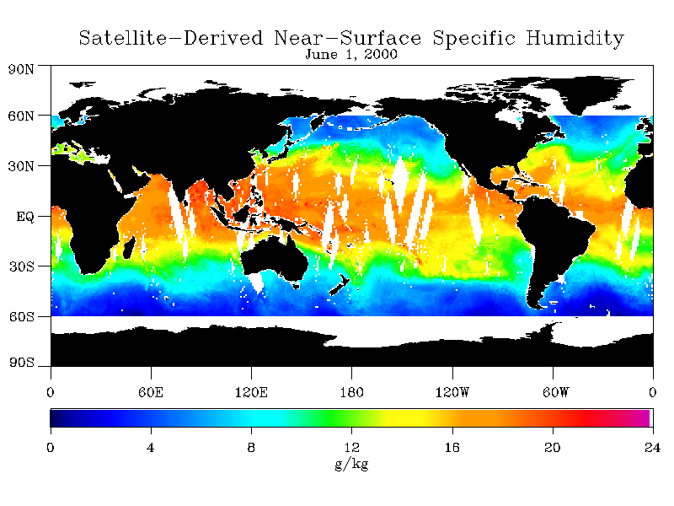
Specific Humidity
The amount of water vapor in the air at a given time and place.

Slide 6
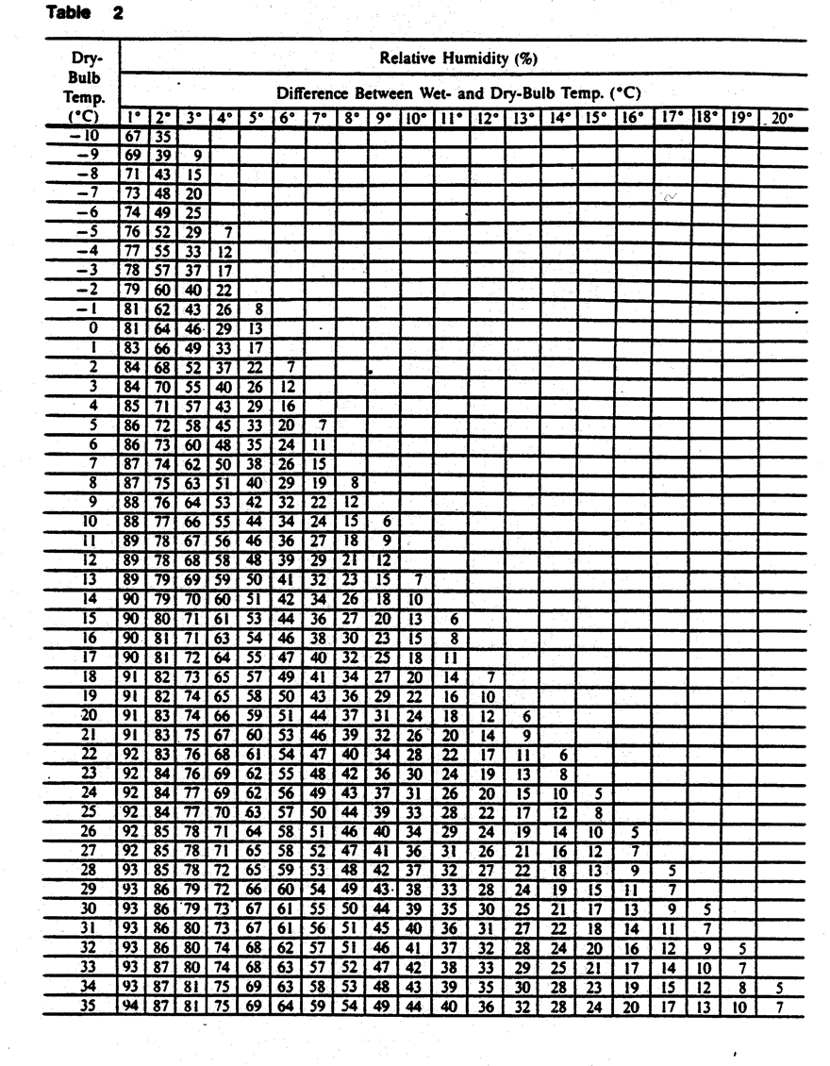
Relative Humidity
How near the air is to maximum capacity for holding water vapor.
***This chart is on Page 12 in your ESRT***

Slide 7

Saturated
Condition where the air is holding as much water vapor as possible.

Slide 8
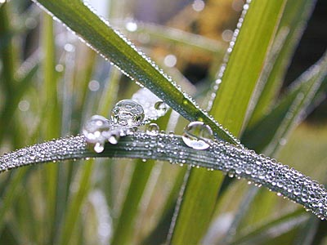
Dew Point
The temperature where saturation occurs and condensation begins.

Slide 9
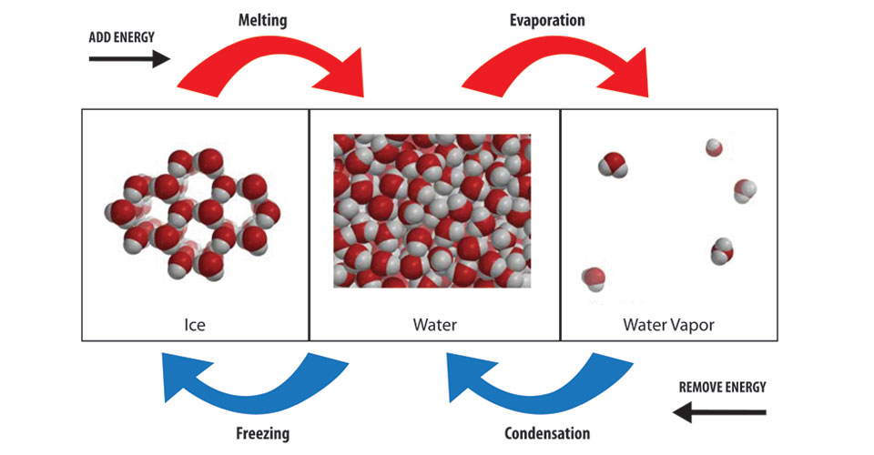
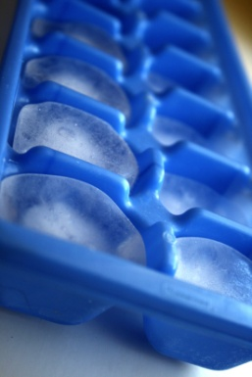
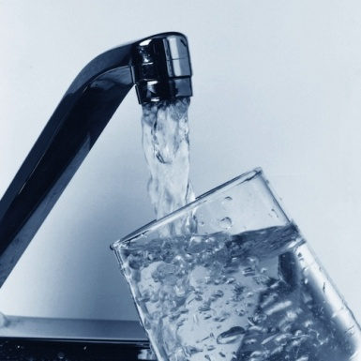
Guided Notes
Depending on its temperature, water can be either a solid, liquid, or a gas.

Slide 10
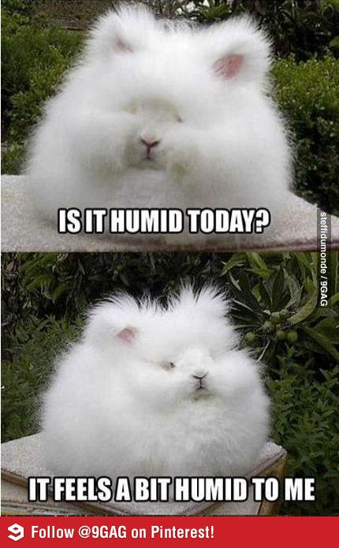
Guided Notes
Although you cannot see water vapor, sometimes you can feel it. The more water vapor in the air, the more humid the air feels.

Slide 11
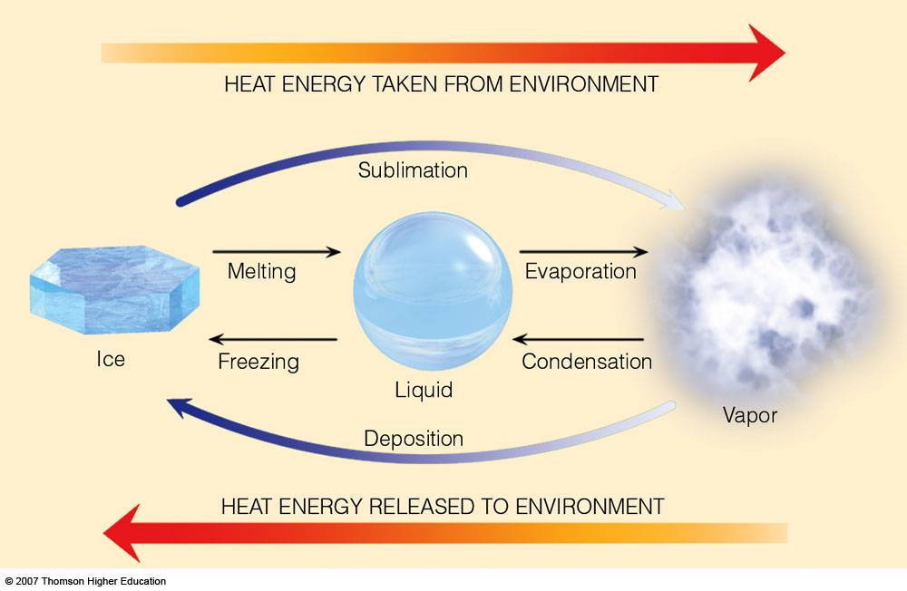
Guided Notes
Water often changes state in the atmosphere. When water changes from one state to another energy is either absorbed or given off.

Slide 12
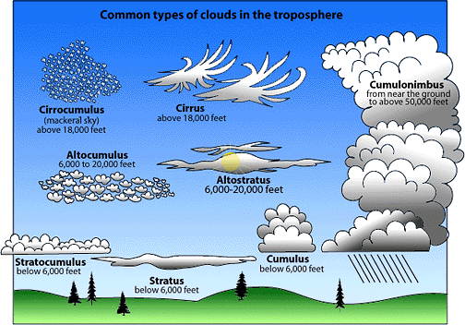
Guided Notes
The change from water vapor to liquid water is called condensation. Products of condensation include dew, fog, and clouds.

Slide 13
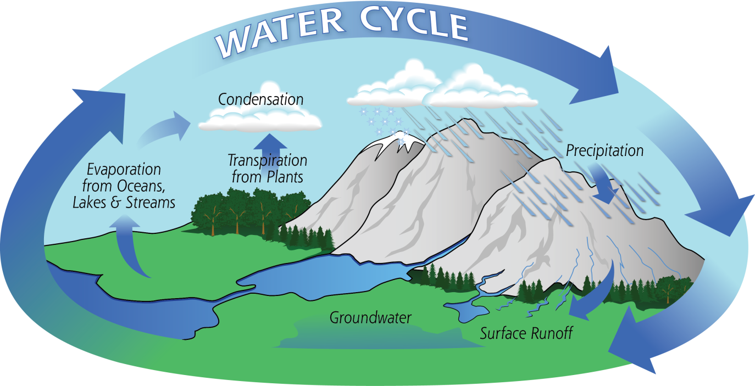
Guided Notes
The change from liquid water to water vapor is called evaporation.

Slide 14
Guided Notes
The actual amount of water vapor in the air at a given time is called specific humidity.
There is a limit to the amount of water vapor that can be present in the air.
When there is so much water vapor in the air that the rate of condensation equals the rate of evaporation, the air is saturated.

Slide 15

Guided Notes
If any additional water evaporates into saturated air, an equal amount will condense.
The water droplets on the side of a water bottle demonstrate this concept.

Slide 16
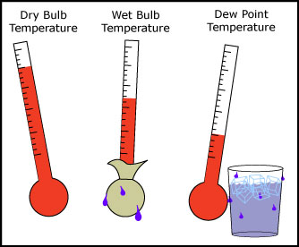
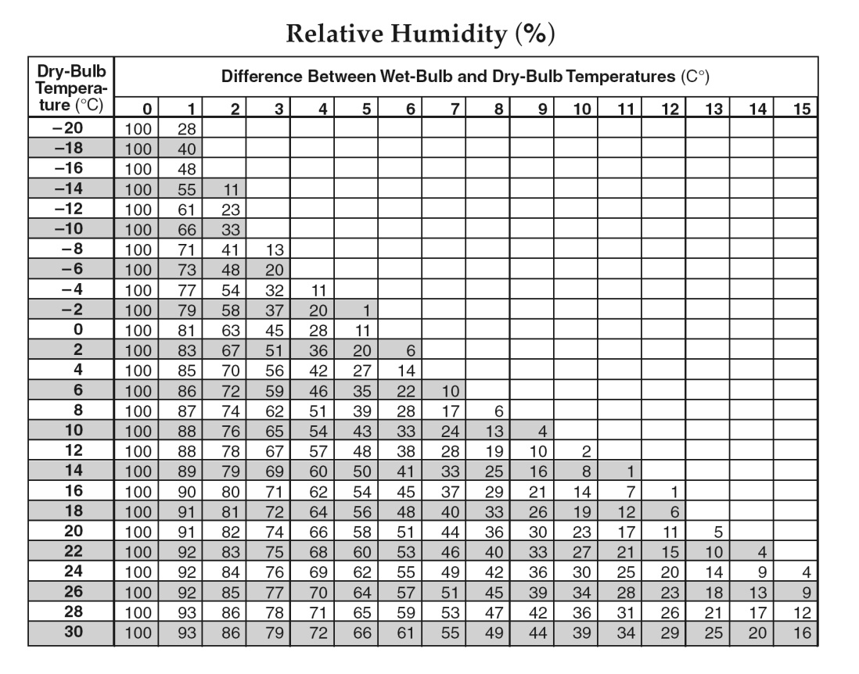
Guided Notes
Remember the Sling Psychrometer experiment in lab?
Record the temperatures of both thermometers.
Spin the thermometers to get the temperature of both thermometers (both should be same temperature).
Put water on the cloth of the wet-bulb thermometer.
Spin the thermometers again for about 30 seconds and you will notice the wet bulb temperature will drop (why does it drop?)
Record the temperatures again and use the chart in page 12 of the ESRT.
Remember to use the difference between the two thermometers and the dry-bulb reading.

Slide 17

Guided Notes
Practice Question!
The Dry-Bulb temperature is 20 degrees Celsius and the Wet-Bulb temperature is 12 degrees Celsius.
What is the relative humidity?
Answer is 36%

Slide 18
Guided Notes
The amount of water vapor present in saturated air depends on the temperature of the air.
The warmer the air, the more water vapor it can hold.
Think of two different size sponges. Both may be saturated but the smaller sponge will always hold less water!

Slide 19
Guided Notes
Relative humidity compares the actual amount of water vapor in the air with the maximum amount of water vapor that can be present in the air.

Slide 20
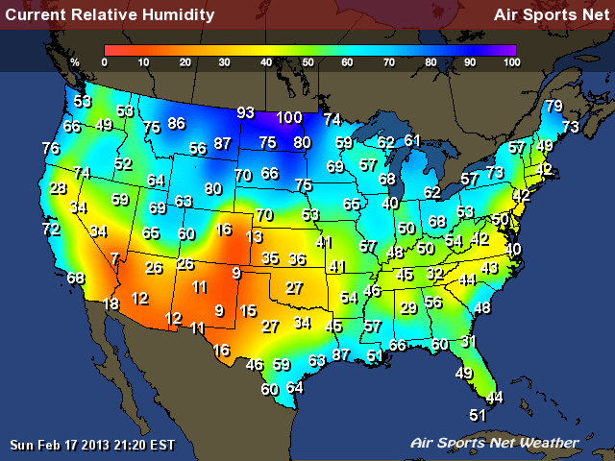
Guided Notes
Relative humidity is usually stated as a percentage.
Saturated air has a relative humidity of 100 percent; air that contains no water vapor has a relative humidity of 0 percent.

Slide 21
Guided Notes
Two conditions are necessary for water vapor to condense:
There must be material for water vapor to condense onto and
Air must cool to or below its dew point.

Slide 22
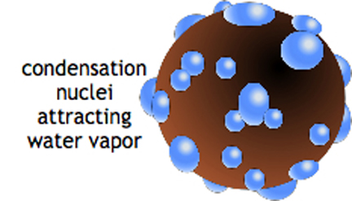
Guided Notes
When fog or clouds form, the water vapor is condensing on tiny particles called condensation nuclei.

Slide 23
Guided Notes
The dew point is a measure of the amount of water vapor in the air.
The more water vapor the air contains, the less the air has to cool in order for condensation to start, so the higher the dew point.

Slide 24
Guided Notes
When air cools to its dew point through contact with a colder surface, water vapor condenses directly onto that surface.

Slide 25
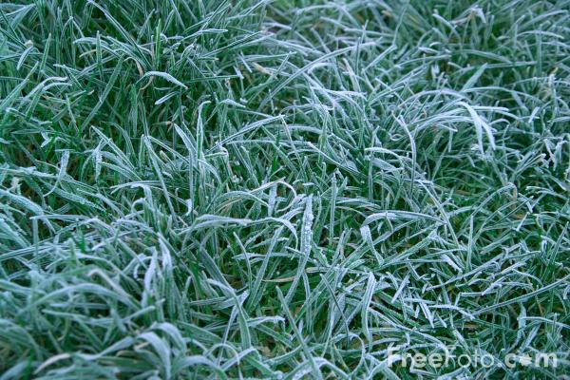
Guided Notes
If the air temperature is above 0 degrees Celsius (32 degrees Fahrenheit), dew forms.
If the air temperature is below 0 degrees Celsius, the water vapor becomes frost.

Slide 26
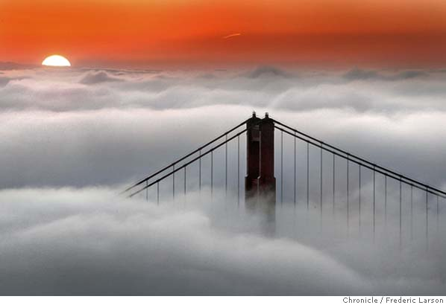
Guided Notes
Fog forms when a cold surface cools the warmer moist air above it. As water vapor condenses in the air, tiny droplets fill the air and form fog.

Slide 27
Guided Notes
The droplets are so tiny that they fall slowly and the slightest air movement keeps them suspended in the air.

